Slide 1
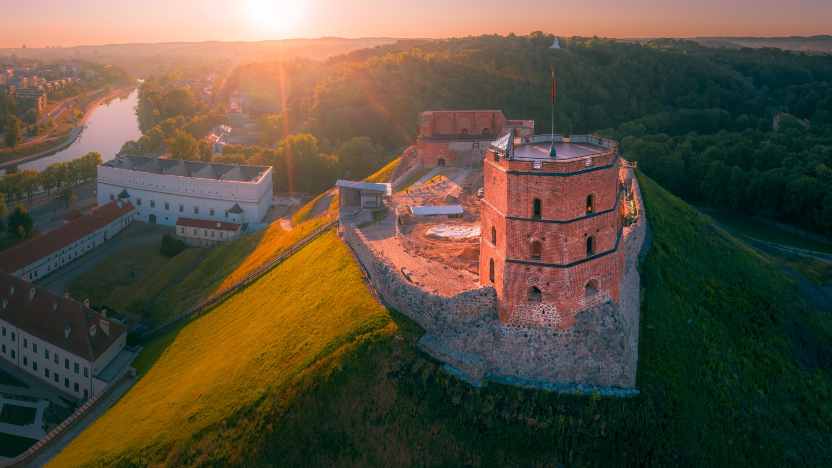
FAMOUS LITHUANIANS

Slide 2
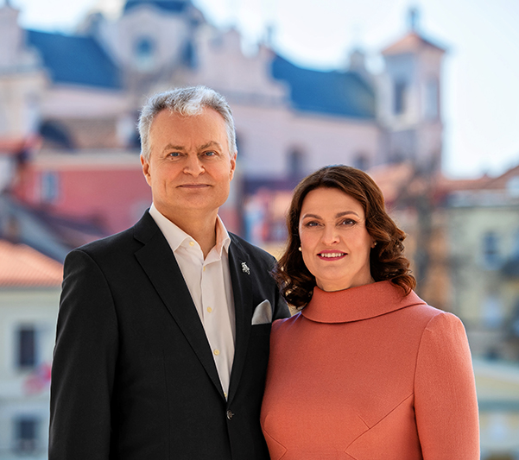
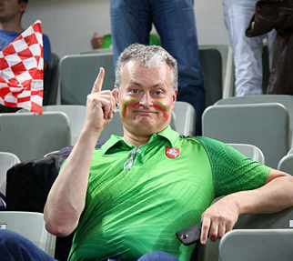
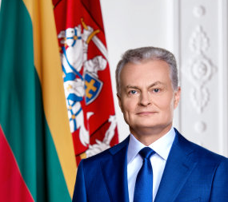
GITANAS NAUSĖDA
THE PRESIDENT of LITHUANIA
( since May 26, 2019 )
Economist, lecturer, politician.

Slide 3
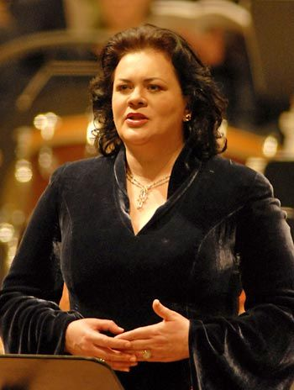

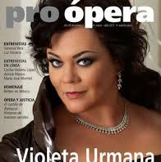
VIOLETA URMANA
A world-celebrated opera singer, Lithuanian opera diva.
For nearly two decades, she has been singing in the most famous European theatres, giving concerts in the renowned halls in Europe, America, Israel, Japan and Russia, often in cooperation with the most talented global conductors and soloists.
Since 2001, she has been regularly invited to major roles in the Metropolitan Opera and the prestigious Lyric Opera of Chicago.

Slide 4
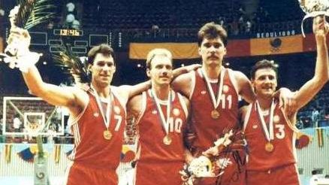

ARVYDAS SABONIS
A legendary Lithuanian basketball player whom the visitors to the NBA.com website elected as the NBA's greatest impact foreign player in 1999 and who was enshrined in the FIBA’s Hall of Fame in 2010 .
He is recorded in Lithuania‘s Book of Records being the tallest man - 223, 6 cm.

Slide 5


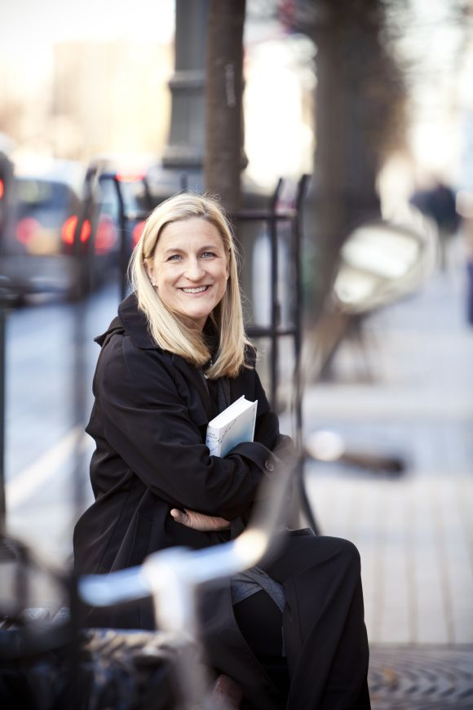

RŪTA ŠEPETYS
Rūta Šepetys is an internationally acclaimed author of historical fiction published in over fifty countries and thirty-six languages.
Rūta is considered a “crossover” novelist as her books are read by both students and adults worldwide.
Her novels, Between Shades of Gray and Out of the Easy are both New York Times bestsellers and international bestsellers.
Her latest novel, Salt to the Sea, is a #1 New York Times bestseller and winner of the Carnegie Medal.
Her books have won or been shortlisted for over forty book prizes, are included on over twenty state reading lists, and are currently in development for film and television.

Slide 6
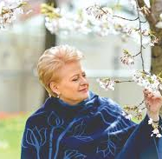
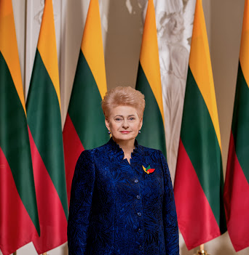
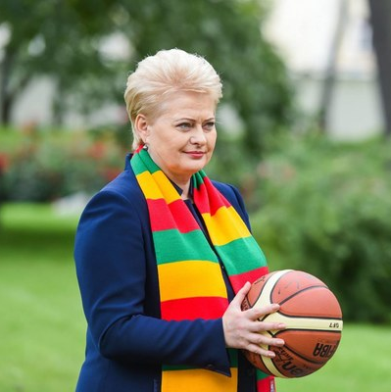

DALIA GRYBAUSKAITĖ
THE PRESIDENT OF LITHUANIA
July 12, 2009 – July 12, 2019

Slide 7
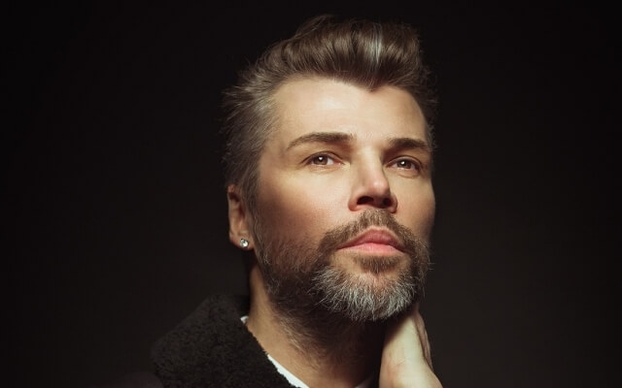
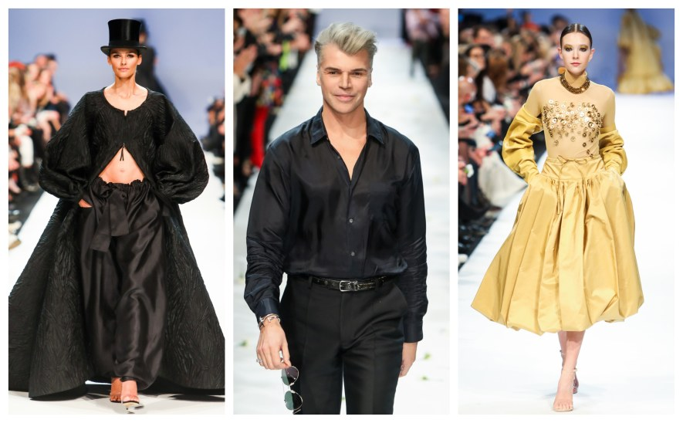
JUOZAS STATKEVIČIUS
The most prominent Lithuanian fashion designer, has also contributed to making Lithuania‘s name known in the world.
Statkevičius is the first Lithuanian designer who has presented his designs on the pages of Vogue, L‘Officiel, Elle and Harper‘s Bazaar fashion magazines.
Famous women who wear the clothes made by Statkevičius include the wife of President Valdas Adamkus, Alma Adamkienė, President of the Republic of Latvia Vaira Vykė-Freiberga, wife of Prince Frederick of Denmark, Princess Mary and celebrities, such as Bjork, Kyra Sedgwick, Naomi Watts, Nicole Richie, Audrey Butvay-Gruss, Kirsta Bard, and Svetlana Gryaznova.

Slide 8
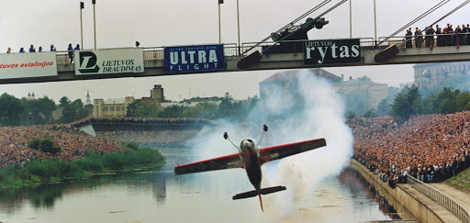
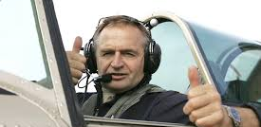
JURGIS KAIRYS
Do you want to know the name of one of Lithuania’s bravest professional aerobatic pilots?
Every Lithuanian would say it is Jurgis Kairys.
He is the winner of many European and world aerobatics championships.
His name became famous among Lithuanians after he has flown under all bridges over the Neris river and his astounding flight in inverted position under a pedestrian bridge in Kaunas.

Slide 9
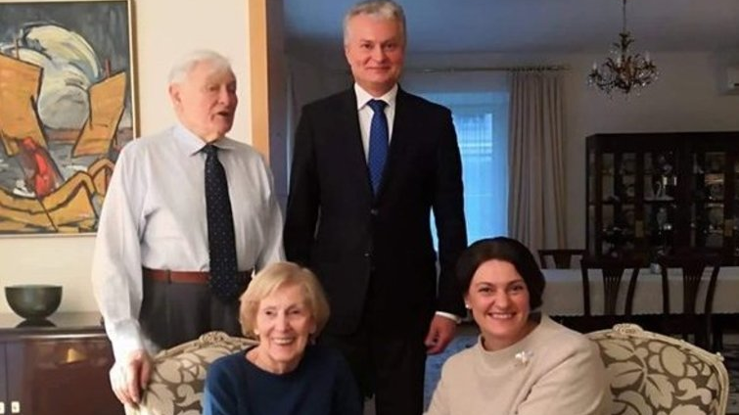
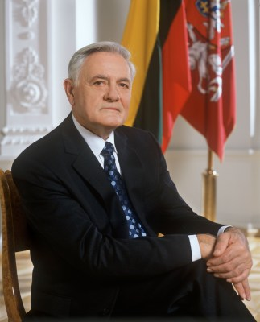
VALDAS ADAMKUS
THE PRESIDENT OF THE REPUBLIC OF LITHUANIA
2004 –2009 ; 1998 –2003

Slide 10
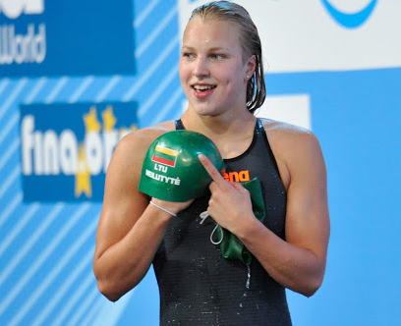
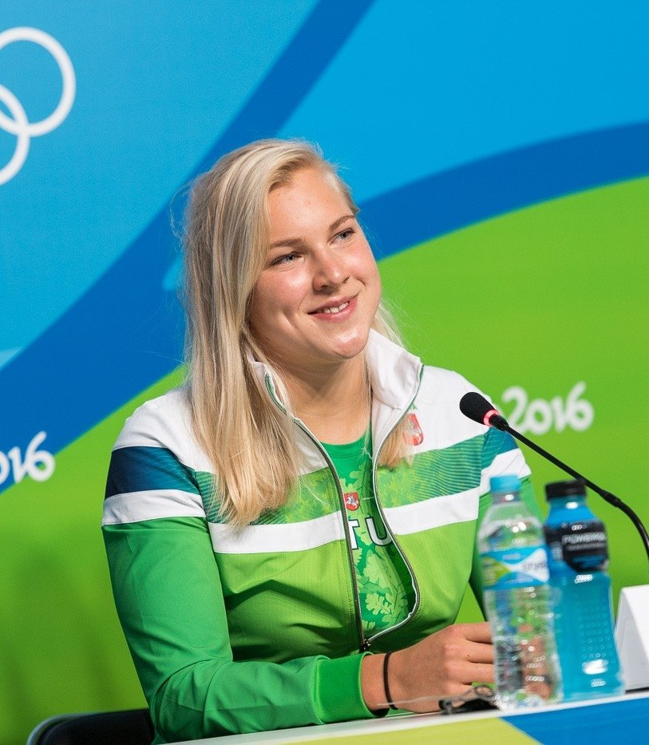
RŪTA MEILUTYTĖ
Olympic, world and European champion.
She became the youngest Olympic 100m breaststroke champion and the first swimming champion since the independence of Lithuania to win a gold medal.
The swimmer was named the best European young athlete of the year 2012 and 2013 by the association of European Olympic Committees.

Slide 11
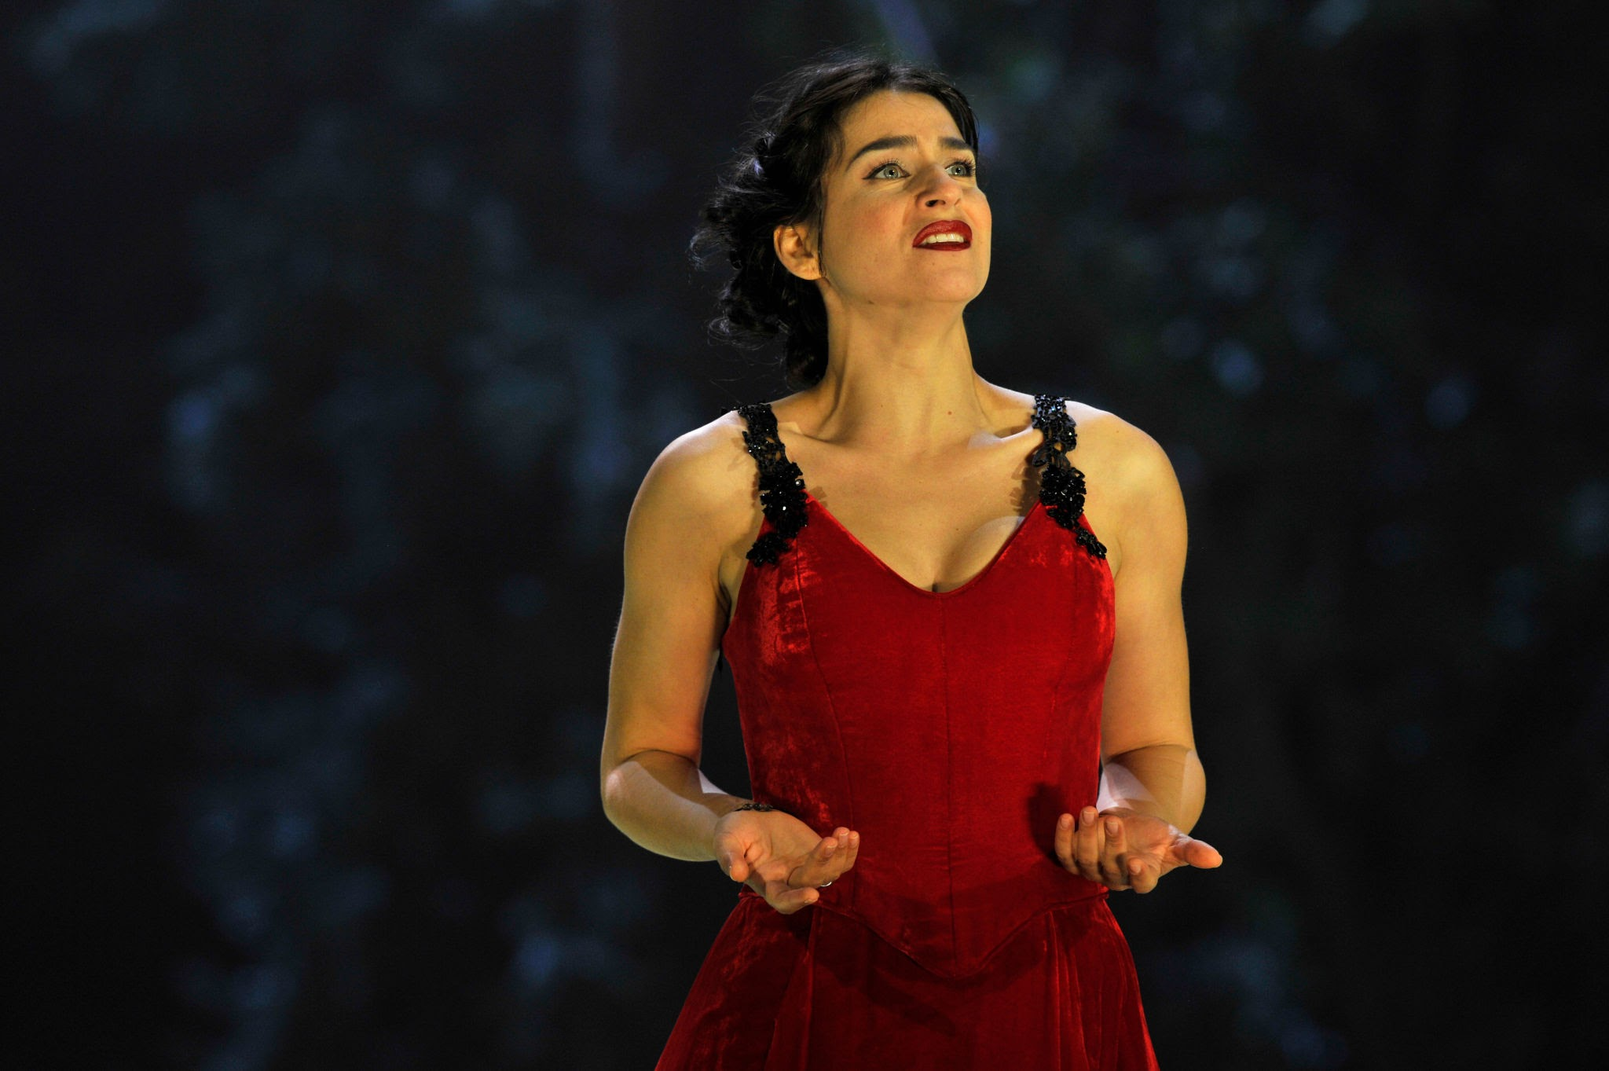
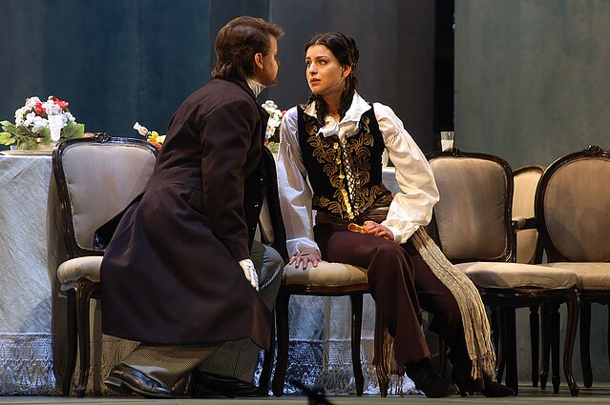
ASMIK GRIGORIAN
Lithuanian operatic soprano.
Since 2011, Grigorian has performed in various opera houses, on the international stages.
In 2019 she was recognized as the best opera singer in the world

Slide 12
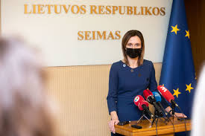
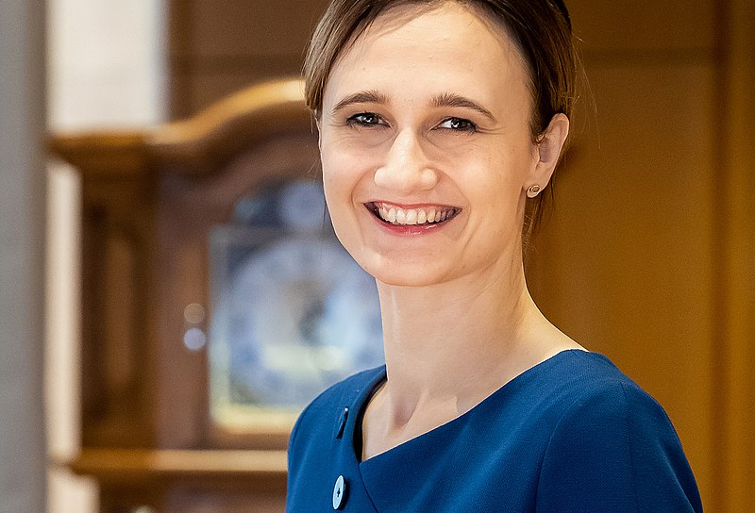
VIKTORIJA ČMILYTĖ - NIELSEN
Chess player, grandmaster (2010 m.), politician.
Since13 November 2020 – the speaker of Lithuanian parliament (the Seimas of the Republic of Lithuania)

Slide 13
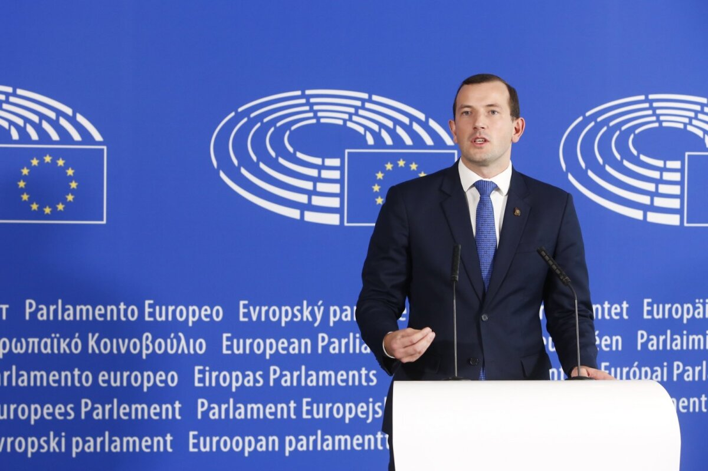
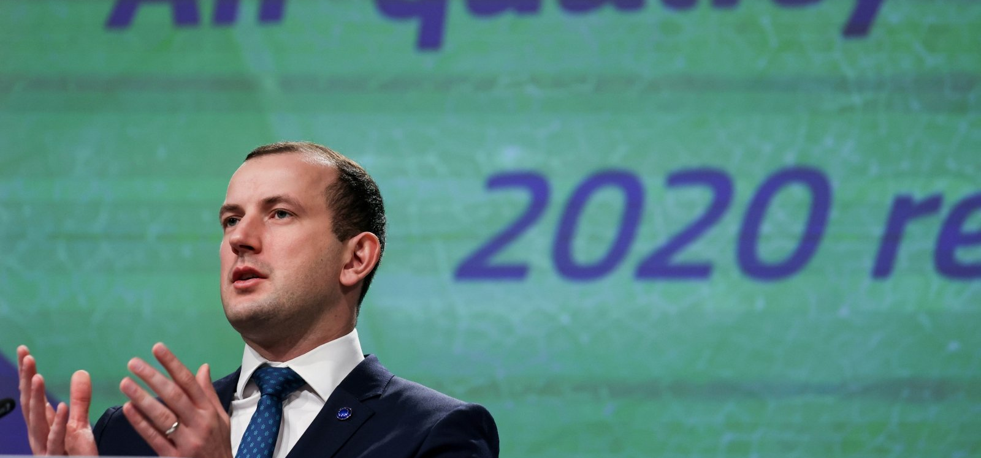
VIRGINIJUS SINKEVIČIUS
THE MEMBER OF EUROPEAN COMISSION
(2019-2024)
Environment, oceans, fishing industry

