Slide 1

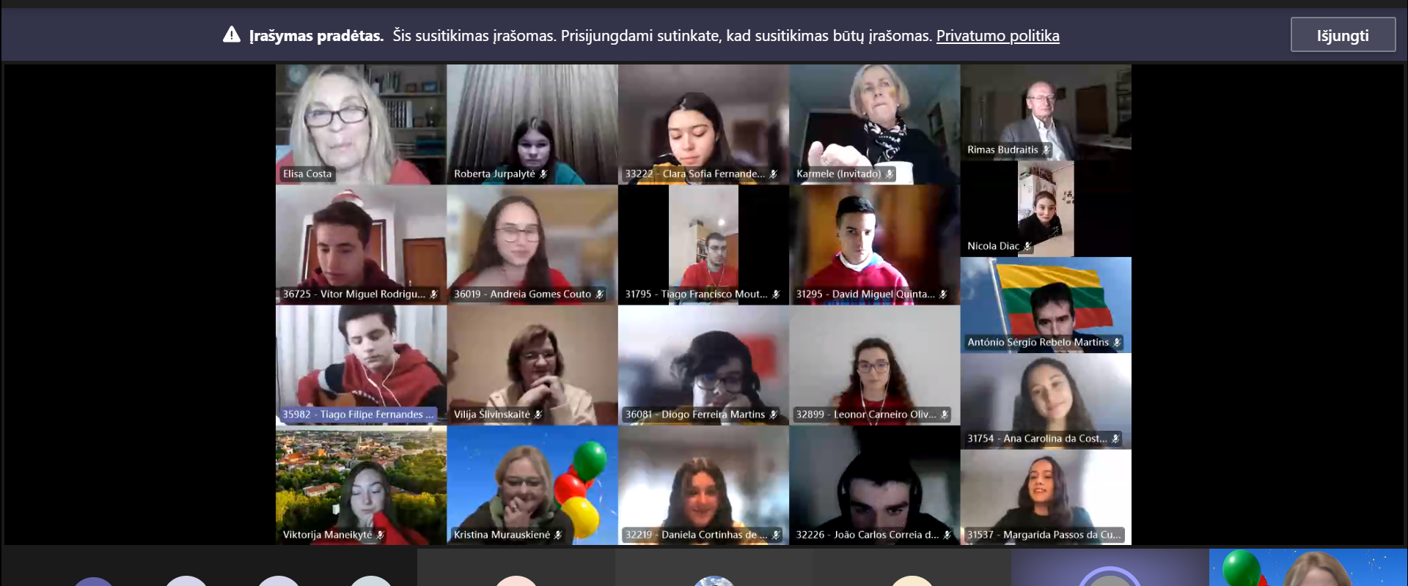
Lithuania Independence Day Celebration, 11 March 1990
(9 March 2021, 4pm CET
Videoconference with students)
REFLECTION

Slide 2

GYMNASIUM ADMINISTRATION
The event is great!!! So nice to meet warm people!
( Rimas Budraitis)
Thank you for the shocking event in the project!!! (Milda Sinickienė)

Slide 3
Reflection of students -72 students participated in the survey:
interesting and I liked -62
interesting, I liked, but took too long- 9
not interesting -1

Slide 4

STUDENTS OF THE EUROPEAN CLUB
GREAT EVENT
GREAT WORK
THANK YOU FOR YOUR JOINT ACTIVITIES

Slide 5
Kristina ir Vilija
Great event
Nice celebration
new experience

Slide 6



MORE THAN FRIENDSHIP

Slide 7

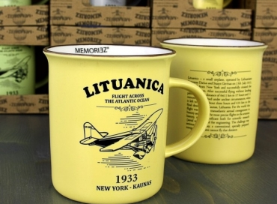
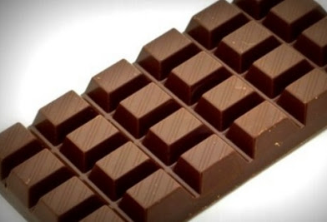
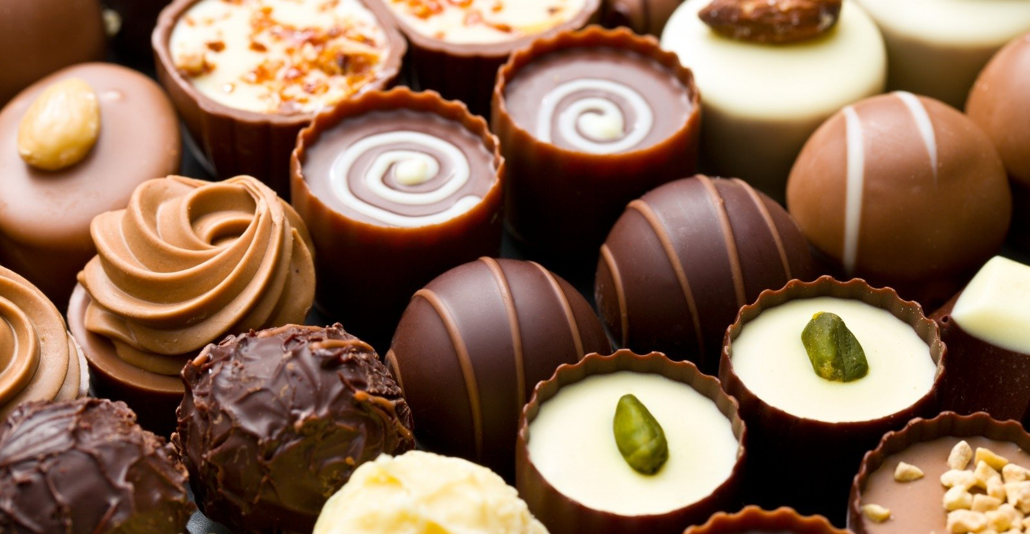
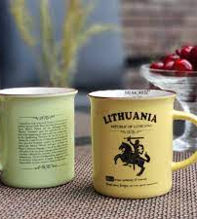

We have sent you gifts. Wait, they are coming ☺

Slide 8

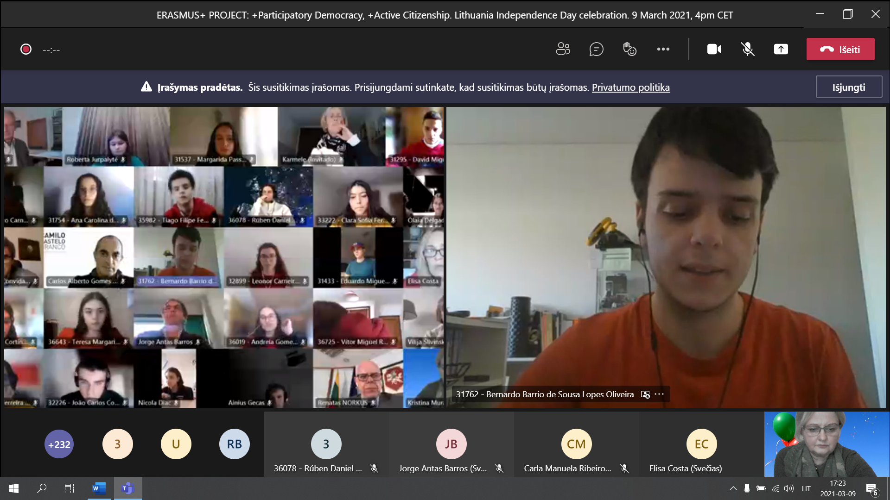
About our event
https://www.skrastas.lt/daugiau/mokyklu-naujienos/kovo-11-oji-juliaus-janonio-gimnazija-sujunge-su-pirenu-pusiasaliu?fbclid=IwAR1f6OK1Op7LI4IEANKSROrSQuTVOyFIysQnGWcl0xzBGBBeCwhxbahA-4E
Newspaper ,, ŠIAULIŲ KRAŠTAS ‘‘

