Slide 1



ERASMUS+ PROJECT
+ PARTICIPATORY DEMOCRACY, +ACTIVE CITIZENSHIP
LOGO CONTEST
1. - CONTEST IS OPEN TO ALL STUDENTS OF 3 SCHOOLS (AGRUPAMENTO DE ESCOLAS CAMILO CASTELO BRANCO, PORTUGAL; SIAULIU JULIAUS JANONIO GIMNAZIJA, LITUÂNIA; URBI, BASAURI, SPAIN)
2. - CONTESTANTS MAY SUBMIT UP THE ORIGINAL ENTRIES. SUBMISSION OF ENTRIES IS UP TO THE 3RD OF NOVEMBER, 2019.
3. - LOGO SHOULD EMBODY OR PORTRAY THE CONTENT OF PROJECT:
+PARTICIPATORY DEMOCRACY, +ACTIVE CITIZENSHIP.

Slide 2
4. - EACH ENTRY MAY BE PICTURE OR TEXT-BASED OR IN COMBINATION. ENTRIES MAY BE DONE BY FREE-HAND IN MARKERS, INK, OIL OR ACRYLIC OR BY COMPUTER. THERE ARE NO COLOR RESTRICTIONS. FILE FORMATS: GIF, JPEG, PNG, RAW, TIFF, BMP. IN DINA5.
5. - EACH LOGO SHOULD BE ACCOMPANIED WITH A BRIEF EXPLANATION/ DESCRIPTION TO PROVIDE CONTEXT TO THE SUGGESTED LOGO (I.E. EXPLANATION OF THE COLORS, SYMBOLS USED, PICTURES, IMAGES, ETC.)
6.-THE LOGO SHOULD CARRY THE NAME OF THE ARTIST. THE DESIGN OF THE LOGO MUST BE CERTIFIED ORIGINAL. THE DESIGNER IS RESPONSIBLE FOR PROVING ITS AUTHENTICITY, SHOULD ANY COMPLAINTS MAY ARISE DUE TO SIMILARITIES, LIKENESS OR COMPARISON OF THE DESIGNS.

Slide 3

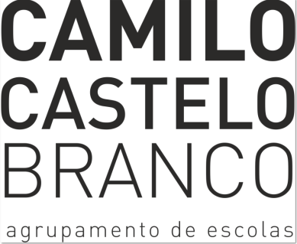

7. - WINNING ENTRY WILL BE USED AS THE OFFICIAL LOGO OF THIS ERASMUS+ PROJECT. IT WILL APPEAR IN EVERY SINGLE DOCUMENT RELATED TO THE PROJECT.
8.- THE ERASMUS+ PROJECT REPRESENTATIVES RESERVE THE RIGHT TO DISQUALIFY ANY ENTRY FOR DIFFERENT REASONS SUCH AS OFFENSES, RUDE WORDS, NOT ADEQUACY WITH THE CONTENT OF THE PROJECT…
9. - IN ORDER TO CHOOSE THE WINNER, THE PRESENTED LOGOS WILL BE VOTED FROM 4TH TO 12TH OF NOVEMBER, 2019.
12. –A WONDERFUL PRIZE AND DIPLOMA AWAITS THE WINNER.
13. - LOGOS MAY SEND TO THE EMAIL ADDRESS OF YOUR TEACHER.

